Slide 1
Compare The Ocular Behaviour of Novices and Visualisation Experts
CSC 8639 Harvey Yuan

Slide 2
INTRODUCTION
Swiftly gaining prominence across various sectors
Data visualisation has traditionally played a pivotal role in financial reporting
BENEFITS OF DATA VISUALISATION
Facilitates clear and concise understanding of financial information
Guidelines simplify complex financial information, making data visualisations easier to understand
AIM & OBJECTIVES
The core aim is to contrast the eye movement patterns of beginners and professionals when observing financial information via various data visualisations
Develop practical guidelines for designing financial data visuals that enhance comprehension and engagement among consumers

Slide 3
Experiment
PARTICIPANTS
METHODOLOGY
Different backgrounds and demographics
  Education, genders, ages, race
Survey to collect this data
Tobii X2-30 eye tracker will capture precise eye gaze data during participants' observations of three visuals, this is placed below the monitor to allow for best tracking
Eye tracker was calibrated for each participant
Each participant had 60 seconds to review each visual
Minimal distractions, all questions and discussions were asked after the 60 second had concluded
FORMAT
Income statement
Sankey Diagram
Waterfall Chart

Slide 4
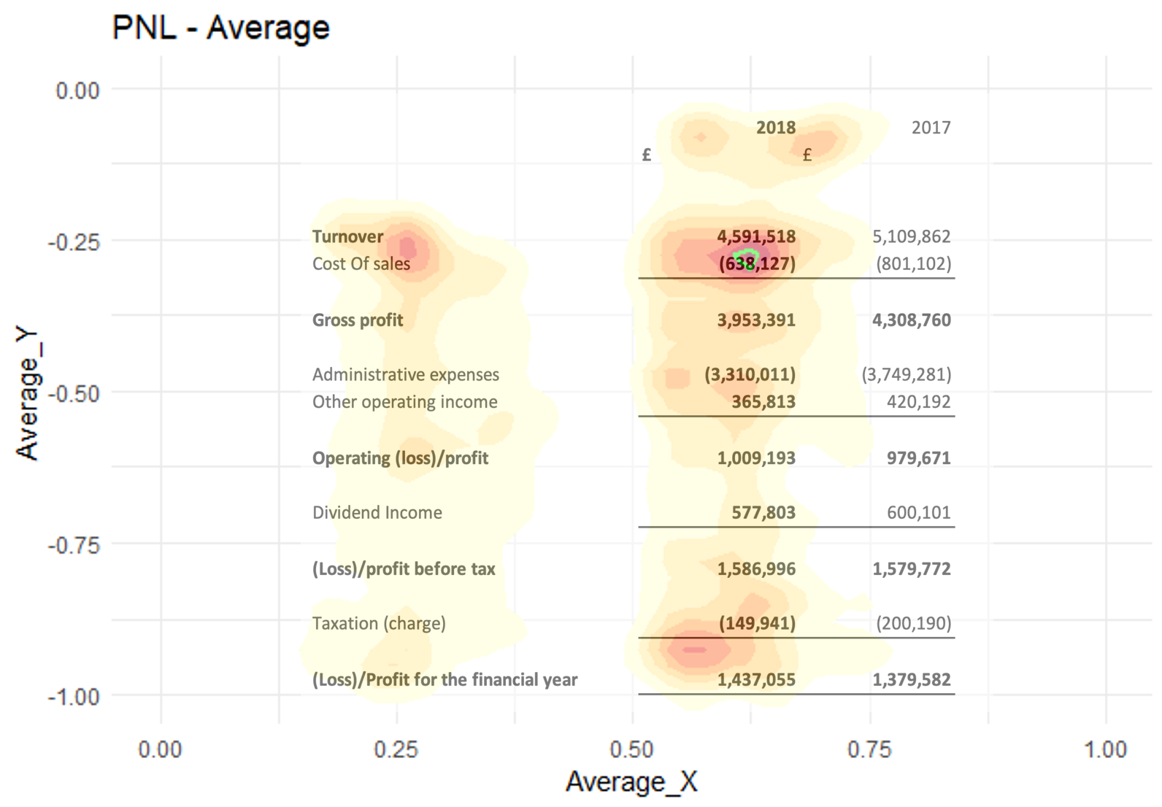
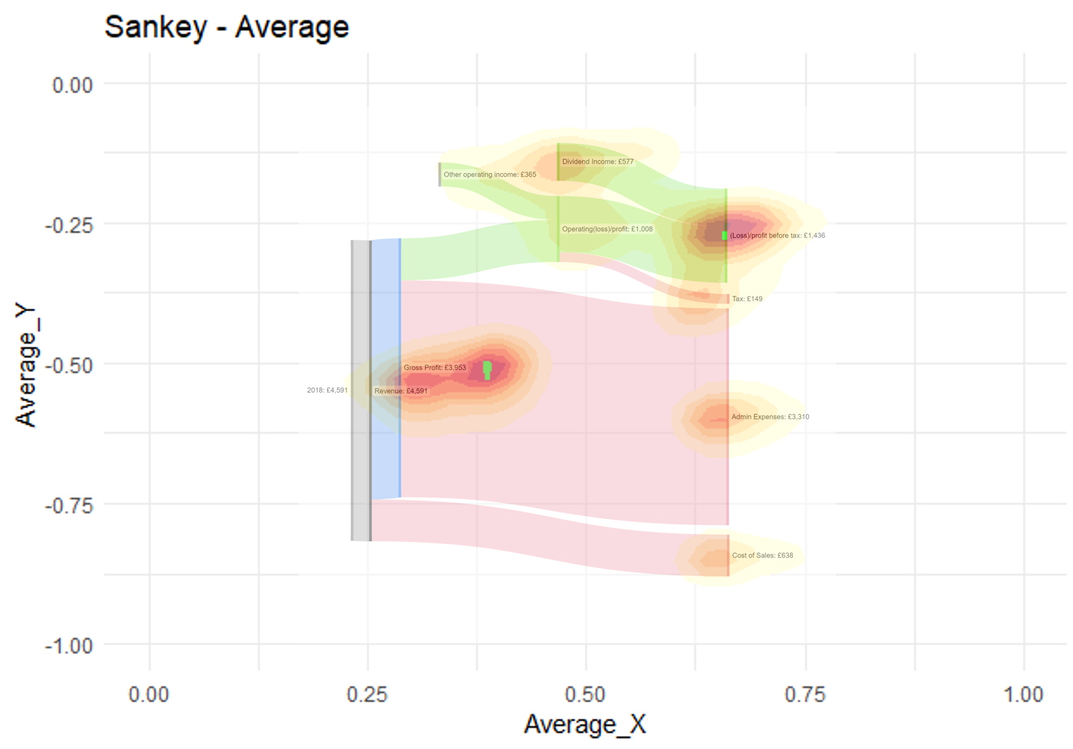
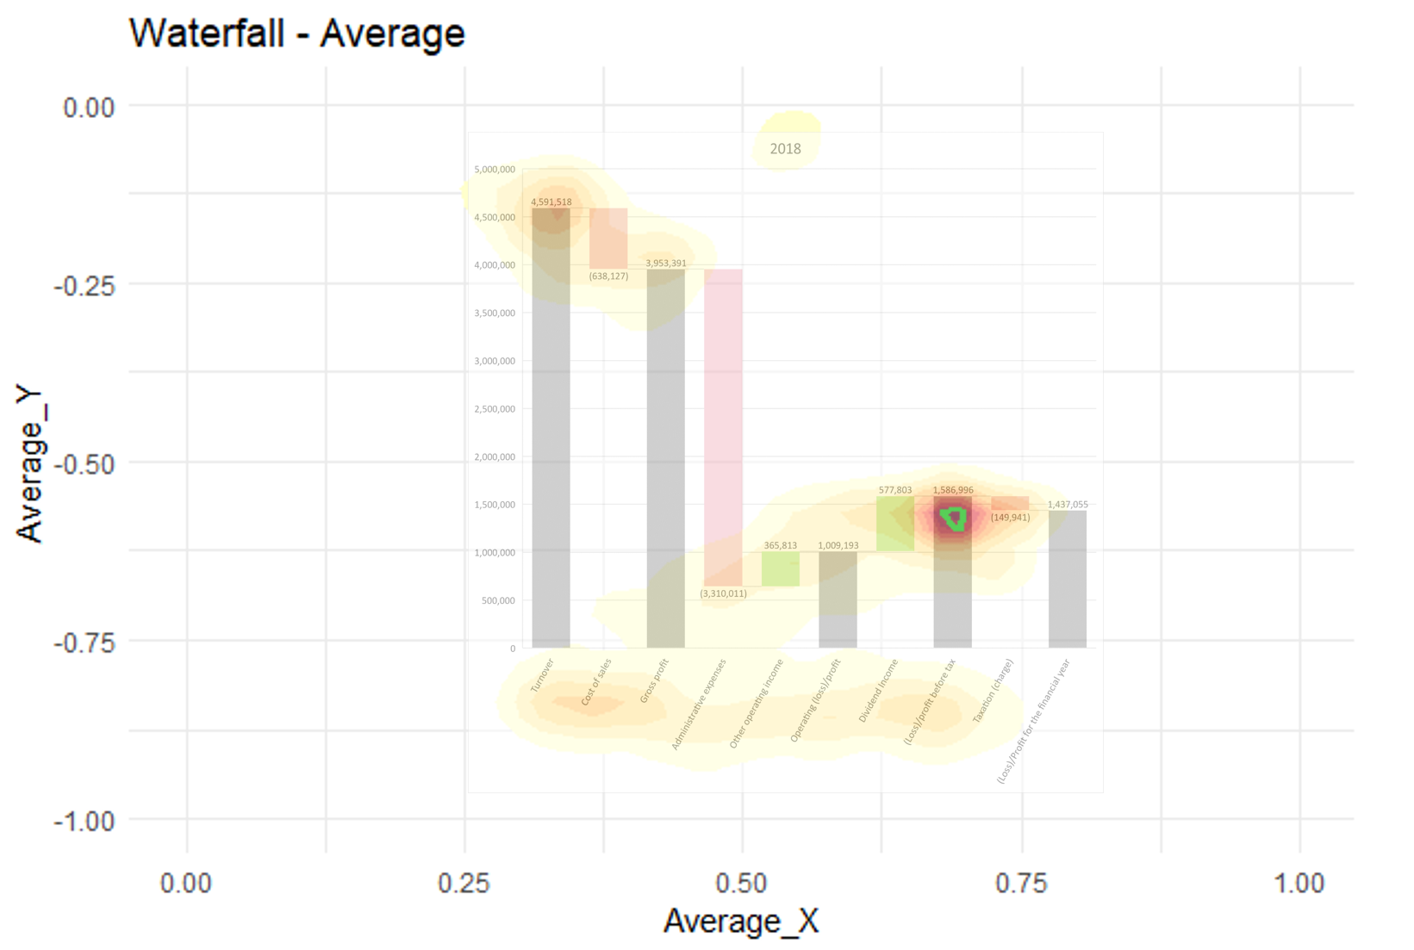
Results

Slide 5



Guidelines
GRAPH
TERMINOLOGY
COLOUR SCHEME
Selecting the correct graph is important
Using straight-forward terminology
Minimalist design and easy to build

Slide 6



Improvements
GRAPH
PARTICIPANTS
STANDARD EQUIPMENT
Conduct the experiment with more data visuals
Use more participants and a more diverse population
Use standard monitor throughout

Slide 7
THANK YOU
Harvey Yuan​

